Slide 1

Working with Text Data
Sentiment Analysis of Movie Reviews
Presented by: Muhammad Mubashir 4160 — Course: Artificial Intelligence

Slide 2
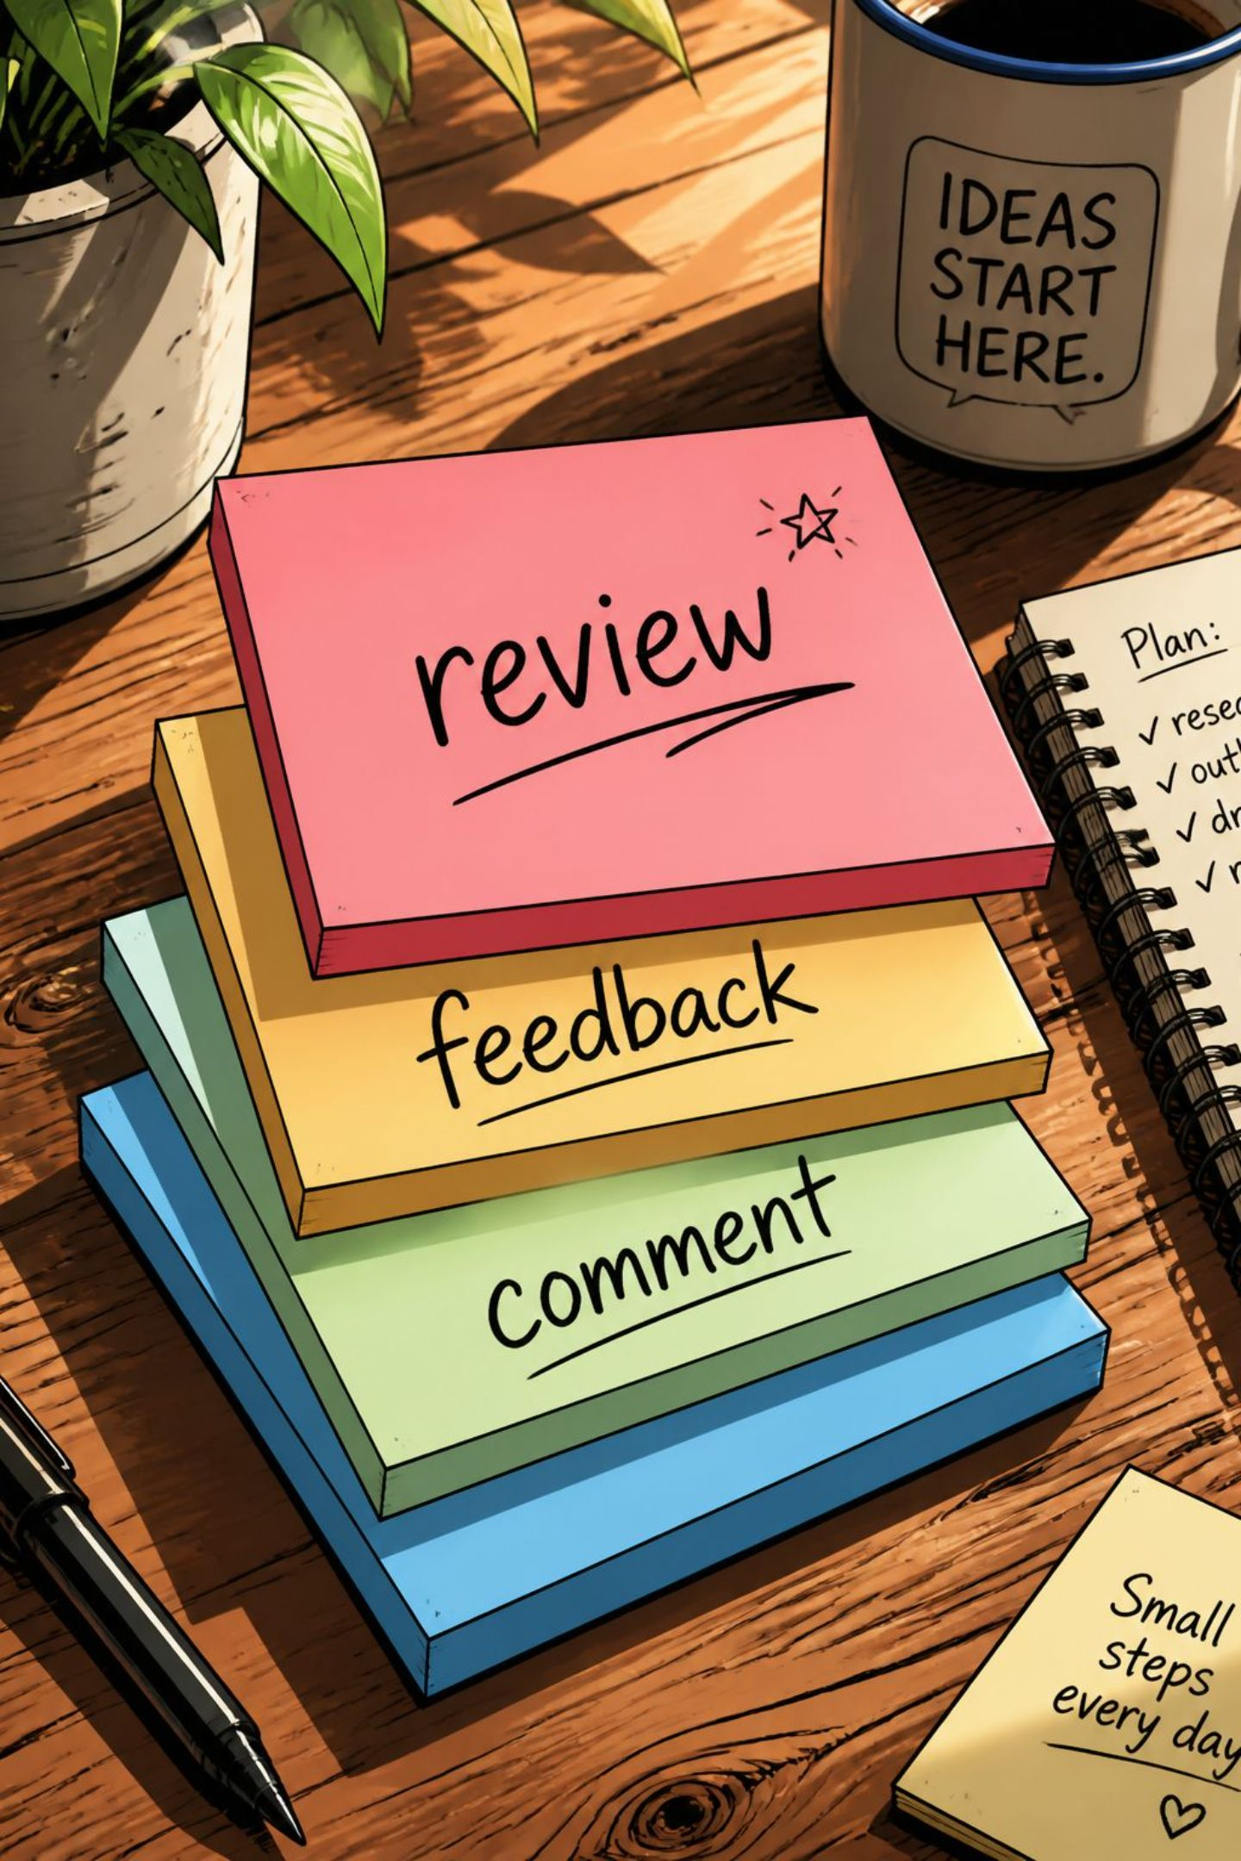
What is Text Data?
Text data is any information expressed in words rather than numbers. It's the raw material for many AI tasks.
Movie reviews
Emails and chat messages
Social media posts and news articles
Customer feedback and support tickets
Example sentence: This sentence is an example of text data.

Slide 3

Types of Data Represented as String
A string is a sequence of characters used to store textual information.
Person name
Email address
Movie review
Product description
Comments & chat messages
Concatenated example (raw input): DataStringNameAliReviewGreat Movie!Emailali@gmail.comCityLahore

Slide 4

What is Text Processing?
Before models can interpret text, data must be prepared through cleaning and transformation.
01
02
Remove noise
Normalise text
Strip punctuation, emojis (if needed), and extraneous characters.
Convert to lowercase and collapse extra spaces.
03
Tokenize & filter
Split into words and remove stop words (common words with little meaning).
Example
Original: "This Movie Is Amazing!!"
Processed: movie amazing

Slide 5


What is Sentiment Analysis?
Sentiment Analysis is an AI technique that detects the emotion or opinion expressed in text.
Positive — conveys praise, enjoyment (😊)
Neutral — factual or indifferent tone (😐)
Negative — displeasure or criticism (☹)
Uses natural language processing (NLP) and machine learning models to map words and phrases to sentiment labels.

Slide 6
Example Movie Reviews & Labels
Movie Review
Sentiment
The movie was fantastic.
Positive 😊
It was an average movie.
Neutral 😐
I hated this movie.
Negative ☹
Excellent acting and story.
Positive 😊
Waste of time.
Negative ☹
These labelled examples form the training and evaluation data for supervised sentiment models.

Slide 7
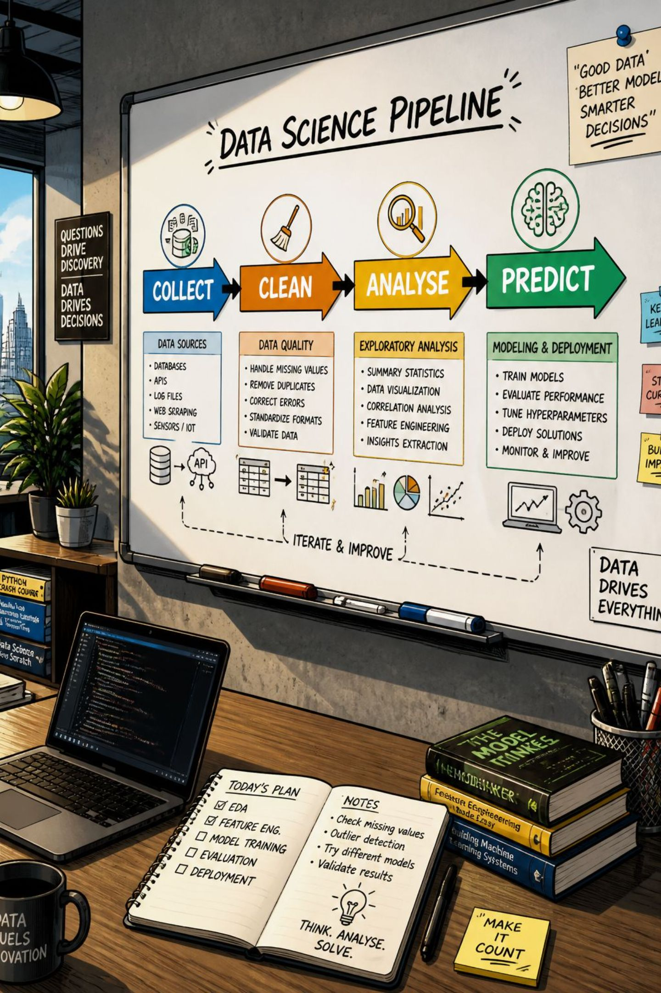
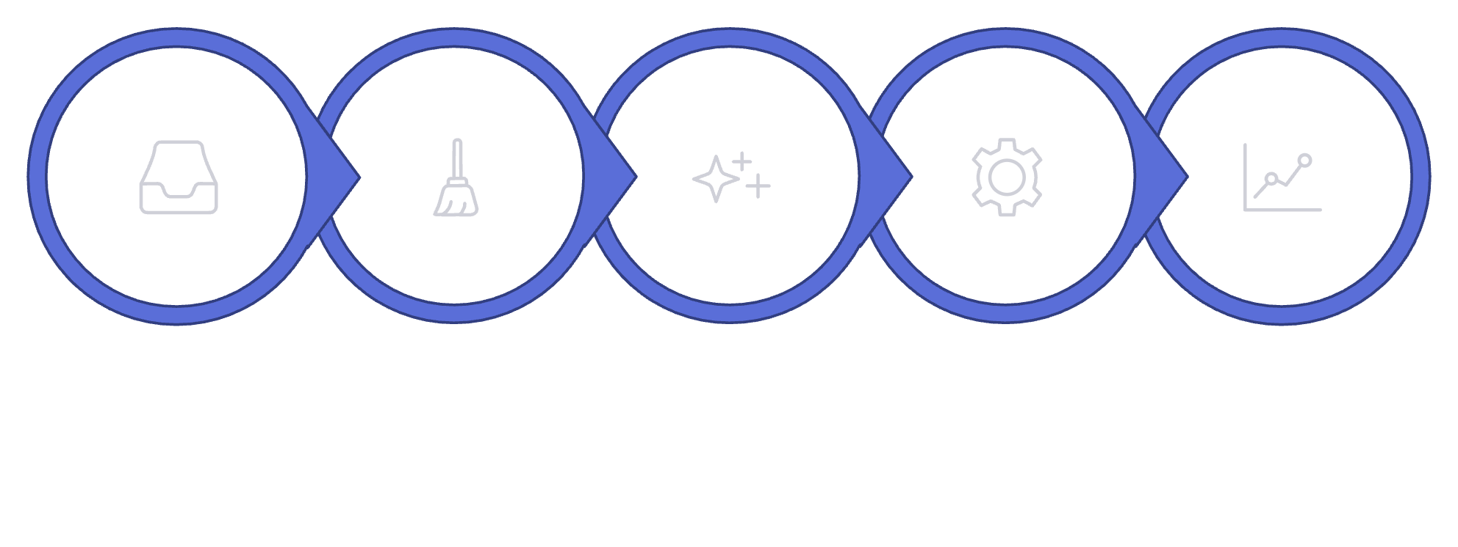
How Sentiment Analysis Works
Collect Reviews
Clean Text
Extract Features
Train / Infer
Output Sentiment
Caption: A streamlined pipeline shows how raw reviews become labelled sentiment outputs used in reporting or product decisions.

Slide 8
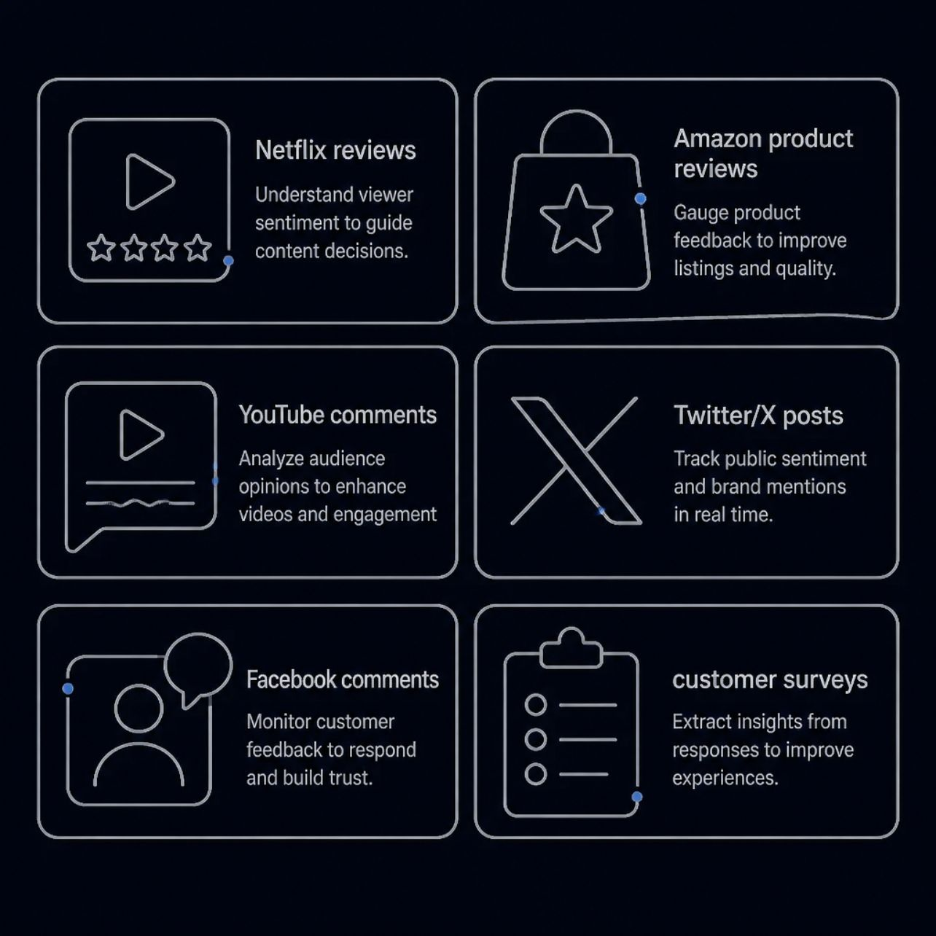
Real‑Life Applications
Companies use sentiment analysis to turn large volumes of text into actionable insights.
Monitor public reaction to new films (streaming platforms)
Analyse product feedback to guide improvements (e‑commerce)
Detect trends and moderate toxic content on social media
Summarise customer sentiment at scale for decision-makers
Example: Thousands of movie reviews reveal whether audiences enjoyed a title and why.

Slide 9

Advantages of Automated Sentiment Analysis
Speed
Scalability
Quickly checks thousands of reviews and comments.
Handles large datasets without proportional human efforts
Customer understanding
Better decisions
Helps identify what customers like, dislike, or want
Helps businesses improve their products, marketing, and services..

Slide 10
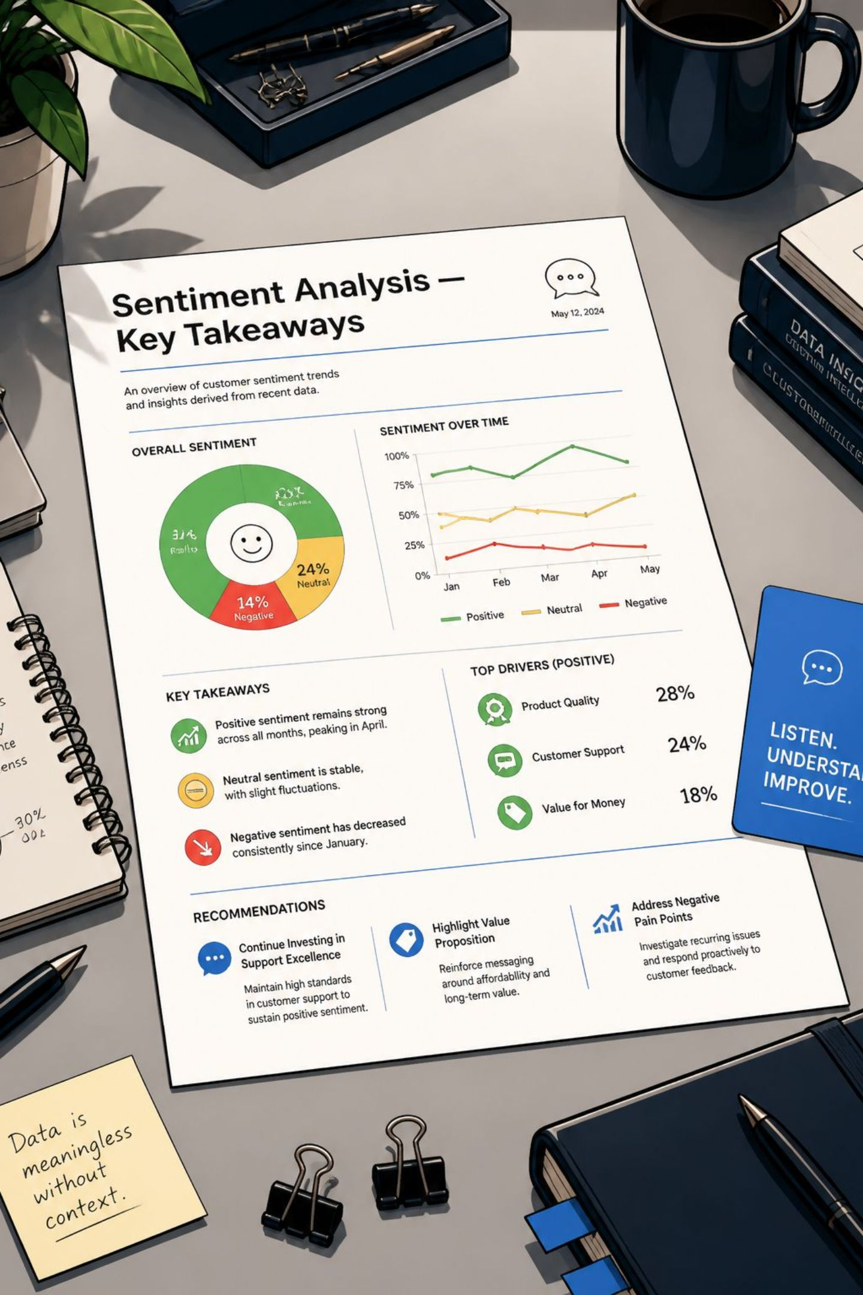
Conclusion & Key Takeaways
Text data is stored as strings and includes reviews, comments and messages.
Clean, tokenised text improves model accuracy.
Sentiment analysis classifies text as Positive, Neutral or Negative.
Applied at scale, it saves time and supports better business decisions.
Next steps: gather labelled reviews, choose features (bag-of-words or embeddings), and evaluate model performance on a holdout set.

Slide 11
Thank You

